Slide 1



presented by : Shaima Khiari , Imen Saad , Roudayna Azizi , Achref Khaled
PayPal insights
a deep dive into world’s most popular payment app

Slide 2
paypal insights
01
06
business context
executive dashboard
02
07
problem statement
deep dive dashboard
03
08
agenda
project objective
key insights
09
04
limitations and future work
data overview
05
10
data modeling
conclusion

Slide 3



paypal insights
PayPal is a global digital payment platform that processes millions of transactions every day across different countries, payment methods, and merchant
categories.
business context

Slide 4
paypal insights
In such a highly competitive and risk-sensitive environment, PayPal must continuously monitor transaction performance, customer behavior, and fraud indicators
business context

Slide 5
paypal insights
Business Intelligence plays a key role in transforming transaction data into actionable insights that support strategic and operational decision-making.
business context

Slide 6
paypal insights
Managing large volumes of digital payment transactions presents several challenges:
Monitoring transaction performance in real time
Identifying revenue-generating markets and payment methods
Detecting fraud risks early
Supporting data-driven business decisions
problem statement

Slide 7
paypal insights
Managing large volumes of digital payment transactions presents several challenges:
Monitoring transaction performance in real time
Identifying revenue-generating markets and payment methods
Detecting fraud risks early
Supporting data-driven business decisions
problem statement

Slide 8
paypal insights
Managing large volumes of digital payment transactions presents several challenges:
Monitoring transaction performance in real time
Identifying revenue-generating markets and payment methods
Detecting fraud risks early
Supporting data-driven business decisions
problem statement

Slide 9
paypal insights
Managing large volumes of digital payment transactions presents several challenges:
Monitoring transaction performance in real time
Identifying revenue-generating markets and payment methods
Detecting fraud risks early
Supporting data-driven business decisions
problem statement

Slide 10


paypal insights
03
05
01
Analyze customer interactions with different merchants and services.
Provide actionable recommendations for business growth strategies.
Understand transaction behavior by time and geography.
objectives
02
04
Identify patterns in volume and revenue generation.
Detect fraud trends associated with transaction sizes.

Slide 11


paypal insights
the analysis is based on a simulated PayPal transaction dataset containing:
data overview
Transaction identifiers and timestamps
transactions amount and fees
countries and merchant categories

Slide 12
paypal insights
the analysis is based on a simulated PayPal transaction dataset containing:
data overview
payment methods
transaction status
fraud flag

Slide 13
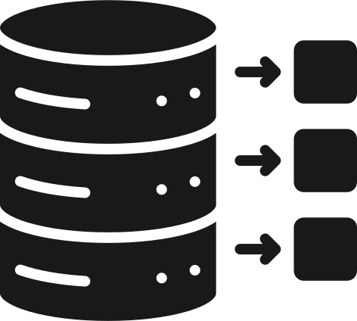
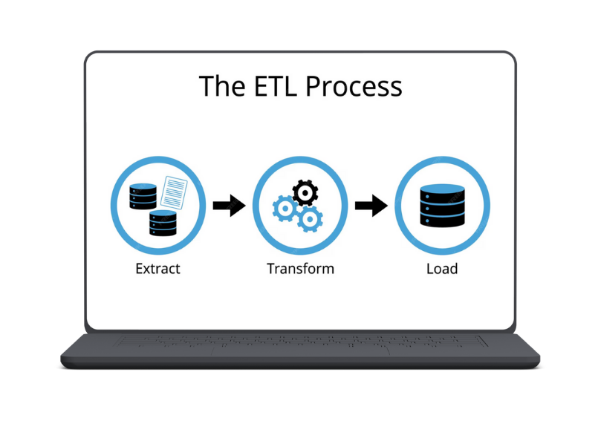

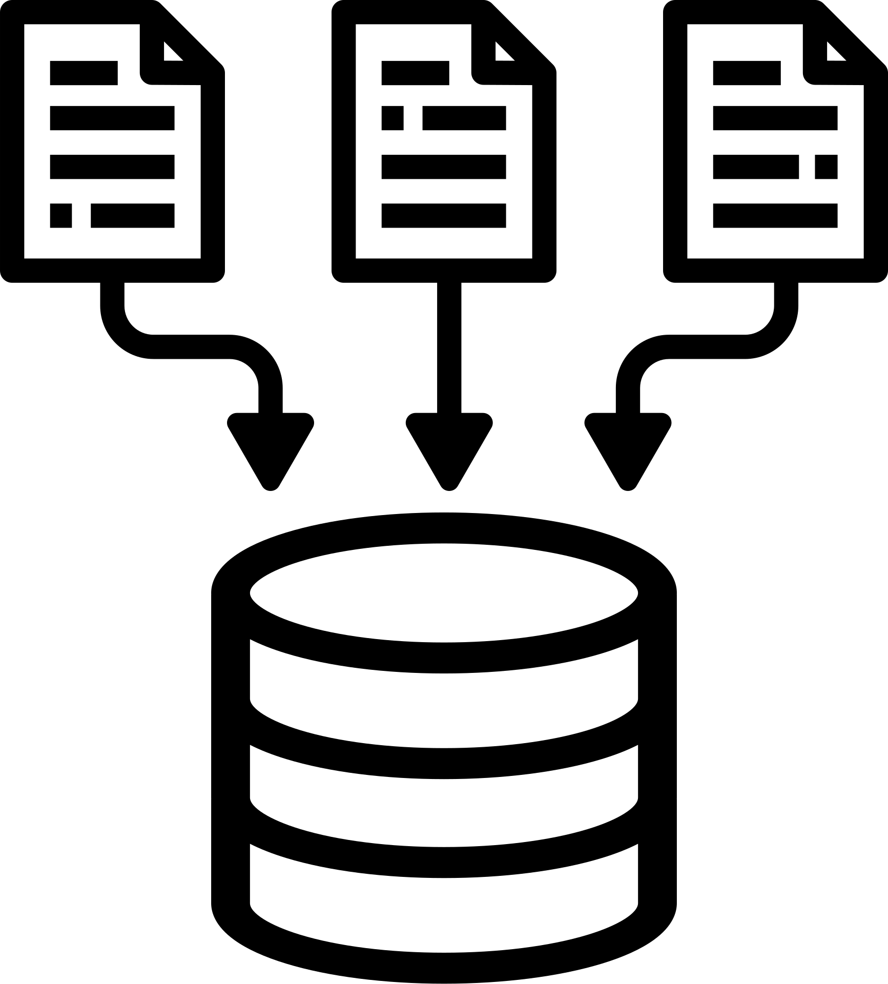
paypal insights
Extract :
Raw transaction data was collected in CSV format
Transform :
ETL process
Removed duplicates
Handled missing values
Standardized date and numerical formats
Load:
Cleaned data was loaded into Power BI for analysis

Slide 14

paypal insights
A dimensional star schema was designed to optimize analytical performance
01
02
data modeling
fact table:
dimensions:
contains trasactions
Date
Country
Payment Method
Merchant Category
This structure simplifies analysis and improves dashboard performance

Slide 15
paypal insights
The Executive Summary dashboard provides a high-level overview of PayPal’s transaction performance. This dashboard enables executives to quickly assess overall performance and trends.
Key indicators include:
02
executive summary dashboard
29 k
0.03 %
8.1 M
total number of transactions
fraud rate
total volume

Slide 16



paypal insights
The Deep Dive dashboard focuses on detailed performance analysis.
It allows users to:
analyze transactions by payment method
compare transaction values across countries
identify patterns related to fraud
deep dive dashboard

Slide 17
paypal insights
The dashboards reveal several important insights:
02
04
01
PayPal Balance is the riskiest payment method; bank transfers are the safest.
03
05
key insights
Transaction volumes are stable across months
Fraud rates are similar across countries, with no major outliers.
Most transactions are successful; failures and refunds are limited
Fraud risk is not driven by volume, but by payment method and controls.

Slide 18





paypal insights
business recommendations
Prioritize optimization of the most frequently used payment methods
Strengthen fraud detection in high-risk regions
Focus marketing and partnerships on high-volume, low-fraud countries countries
Investigate causes of failed transactions to improve reliability

Slide 19
paypal insights
business recommendations
Prioritize optimization of the most frequently used payment methods
Strengthen fraud detection in high-risk regions
Focus marketing and partnerships on high-volume, low-fraud countries countries
Investigate causes of failed transactions to improve reliability

Slide 20
paypal insights
business recommendations
Prioritize optimization of the most frequently used payment methods
Strengthen fraud detection in high-risk regions
Focus marketing and partnerships on high-volume, low-fraud countries countries
Investigate causes of failed transactions to improve reliability

Slide 21
paypal insights
business recommendations
Prioritize optimization of the most frequently used payment methods
Strengthen fraud detection in high-risk regions
Focus marketing and partnerships on high-volume, low-fraud countries countries
Investigate causes of failed transactions to improve reliability

Slide 22


paypal insights
Future Improvements:
Integration of real-time transaction data
Advanced fraud prediction models
Forecasting transaction volume and revenue
Drill-through and alert-based dashboards
limitations :
The dataset is simulated and not real-time
Limited historical data restricts long-term trend analysis
limitations and future improvements

Slide 23
paypal insights
This Business Intelligence project demonstrates how data can be transformed into meaningful insights through structured ETL processes, dimensional modeling, and interactive dashboards.
The proposed BI solution supports informed decision-making, enhances performance monitoring, and contributes to improved operational efficiency and security.
conclusion

Slide 24
THANK YOU

